Slide 1
A Practitioner’s Guide to Contemporary Exploratory Testing
Maaret Pyhäjärvi

Slide 2
ideas leading into this,
changes enabling this, and
results we are seeing
with contemporary exploratory testing

Slide 3
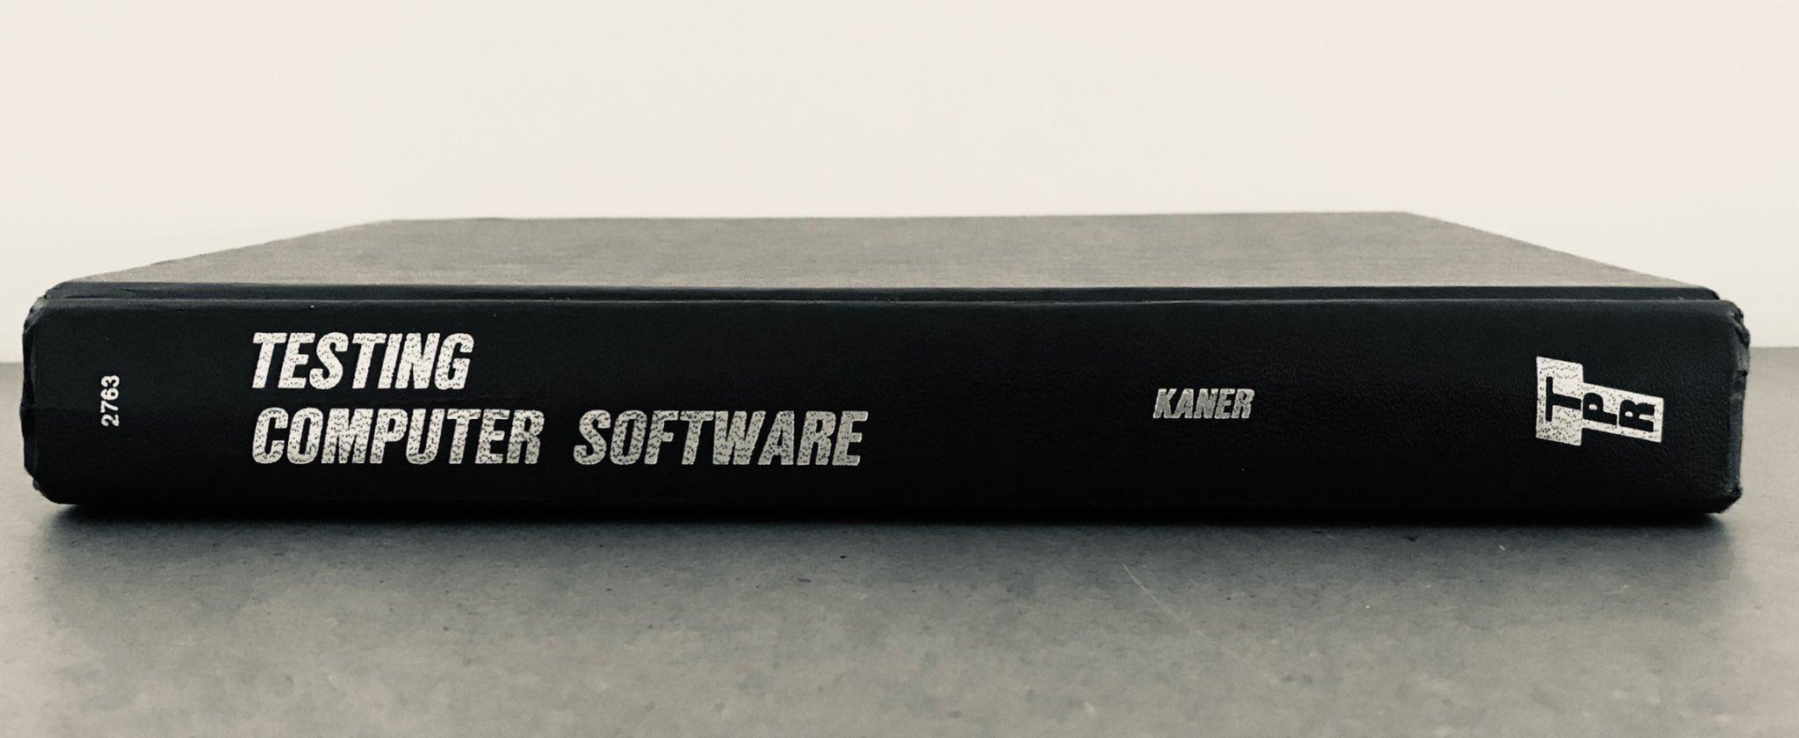
1988
style of skilled multidisciplinary testing common in Silicon Valley
* Spotted live in Finland 1973 (Kela, the Social Insurance Institution in Finland)

Slide 4
Exploratory Testing
TEST DESIGN
TEST EXECUTION
LEARNING,
AGENCY
* power to decide with knowledge and attitude that goes with power
IMPACTFUL RESULTS

Slide 5
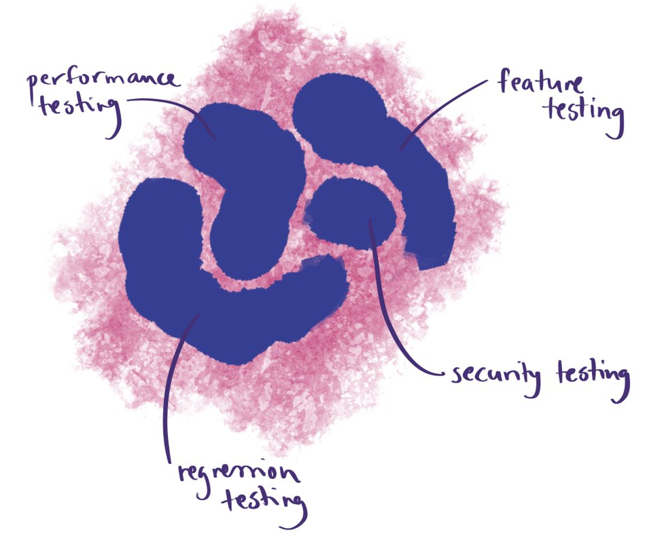
Tier boundary testing
Cross-tenant impact testing
API throttling testing
* From Jyothi Mishra’s Cloud Testing Talk at Axiom Summit

Slide 6
Contemporary Exploratory Testing
MANUAL
AUTOMATED
LEARNING,
AGENCY
* power to decide with knowledge and attitude that goes with power
IMPACTFUL RESULTS

Slide 7
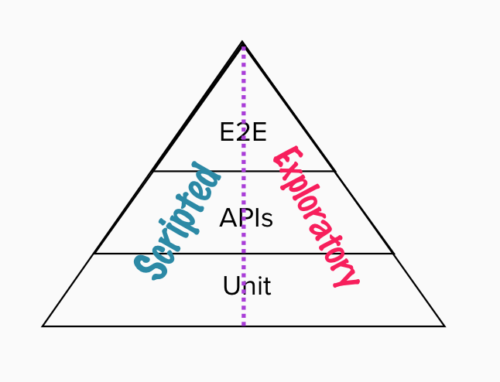
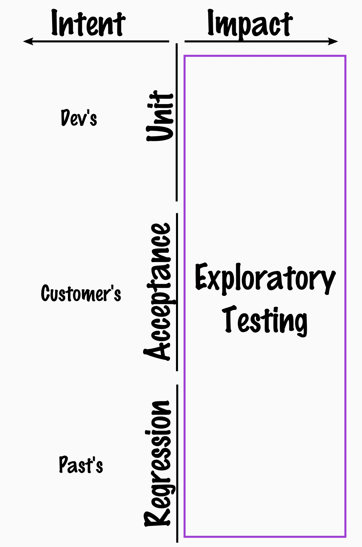

Slide 8
ATTENDED UNATTENDED
* You can't automate well without exploring. You can't explore well without automating.

Slide 9
Time used on warning about test automation is away from succeeding with it.
* opportunity cost

Slide 10


Slide 11
a category of bugs
before implementing
before releasing
after releasing

Slide 12
Grow as Testers
Finding and Sharing New Information Matters
Investment Awareness
Time Dimensions: Now vs. Future
From Reactive to Just-in-Time Reactive
Learn to Learn *really well*

Slide 13
Good Neighbor -principle
Know more than your team

Slide 14
Protect Agency
Continuous Releases: Shorter Increments over Session Based Test Management
Co-Design Workshops over Status Meetings
Pair Testing over Reviewing Test Ideas
Regular Review of Investment and Results

Slide 15
Automation over
Mindmaps over
Title test cases over
Test cases with steps
Evidence as Automation
* You know it is a small part but sufficient for evidence

Slide 16
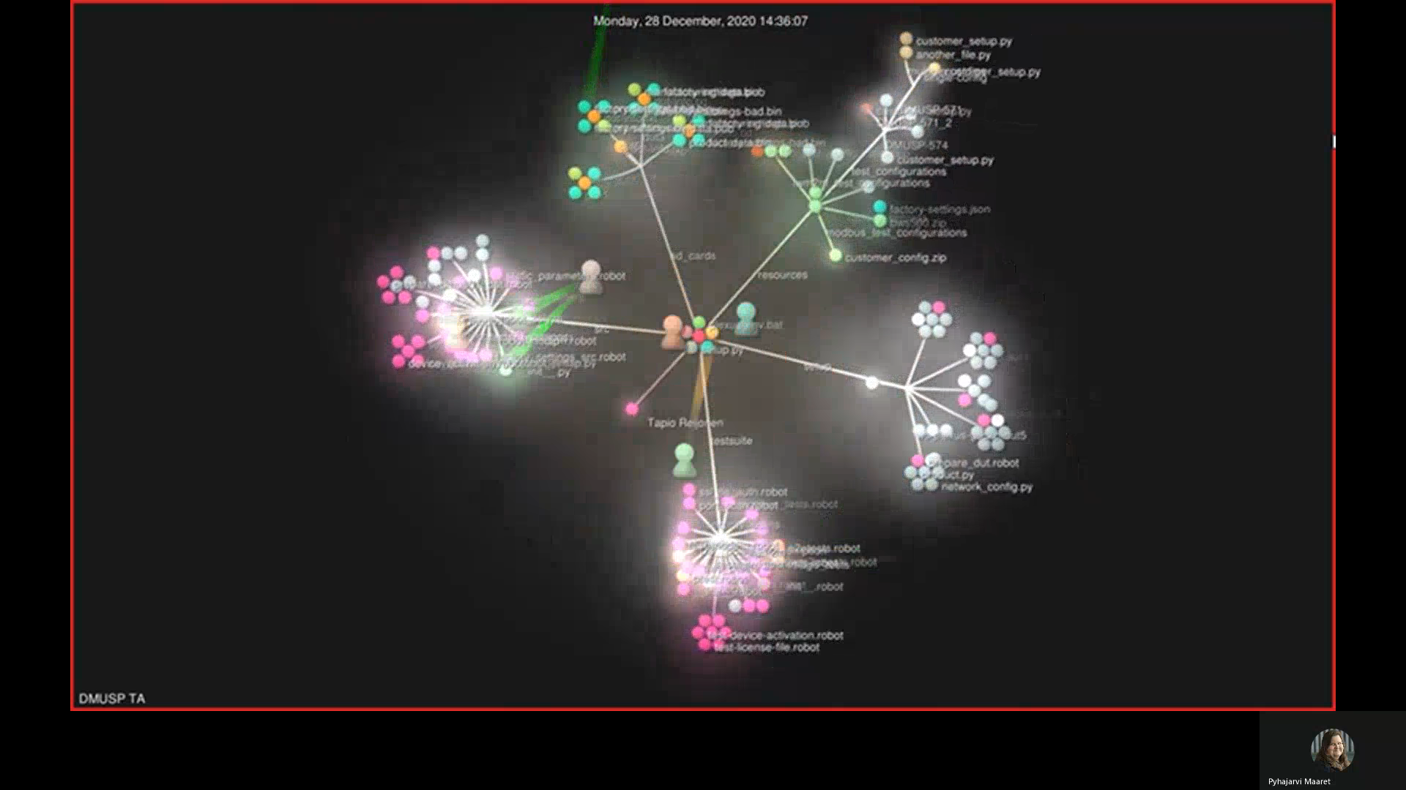
Visualized with gource.io

Slide 17
Perceived Success Factors
Dimension | Factor
Human | Whole team effort
 | Expert team members
 | Self-motivated team members
Organizing | Allow time for learning curve
 | Internal open-source community mindset
Technical | Test tool choice and architecture
 | Testlab infrastructure
 | Product testability
 | Telemetry
Process | Incremental approach
 | Process observation and optimization

Slide 18
Conflict with previous research!
https://www.academia.edu/49495368/Test_Automation_Process_Improvement_in_a_DevOps_Team_Experience_Report
No explicit test automation strategy
No careful tool selection
No measuring quality and performance of TA
No explicit guidelines
“…relaxed, verbally communicated strategy without strict rules and processes relying on developers’ voluntary participation. We consider this an unusual success with TAPI …

Slide 19
Since then…
ENTROPHY INERTIA
WB (fail)
DMU (success)
AMS (success)
AVMT (inconclusive)
VSP (success)
SND (fail)
EPT (inconclusive)
Success / Failure is a Snapshot
PSU (fail)
NM (inconclusive)
FIR (fail)

Slide 20


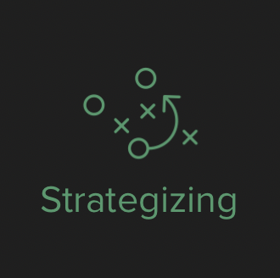




















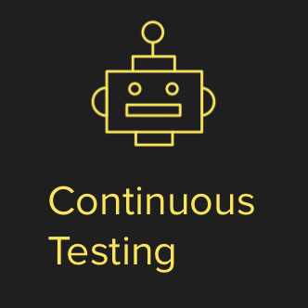










Slide 21



Testing is too important to be left for only testers!
(Exploratory) Tester
Test Automator / Programmer
(Application)
Programmer

Slide 22

Everyone can test
Notes:
Finnish people love karaoke…

Slide 23

Even a broken clock is right twice a day.

Slide 24
Testing
Find (some of) what others may have missed!
… and never be bored.

